Slide 1


E-PILOT:A SYSTEM TO PREDICT HARD LANDING DURING THE APPROACH PHASE OF COMMERCIAL FLIGHTS

Slide 2










1
Abstract
6
Existing System
2
Idea
7
System Architecture
Agenda
3
Objectives
8
System Requirements
4
Problem Statement
9
H2O Algorithm
5
Introduction
10
Conclusion

Slide 3
ABSTRACT
More than half of all commercial aircraft operation accidents could have been prevented by executing a go-around. Making timely decision to execute a go-around maneuver can potentially reduce overall aviation industry accident rate. In this paper, we describe a cockpit-deployable machine learning system to support flight crew go-around decision-making based on the prediction of a hard landing event. This work presents a hybrid approach for hard landing prediction that uses features modelling temporal dependencies of aircraft variables as inputs to a neural network. Based on a large dataset of 58177 commercial flights, the results show that our approach has 85% of average sensitivity with 74% of average specificity at the go-around point. It follows that our approach is a cockpit-deployable recommendation system that outperforms existing approaches.

Slide 4


To develop a reliable predictive model that accurately identifies flights at risk of experiencing hard landings during the approach phase.
Objectives
The E-Pilots system seeks to contribute significantly to the enhancement of flight safety.
To improve operational efficiency within the aviation industry.

Slide 5
PROBLEM STATEMENT
The problem at hand is to develop an innovative and data-driven solution, known as the E-Pilots system, capable of predicting hard landings with precision during the approach phase of commercial flights.
This entails harnessing the power of machine learning and advanced data analysis techniques to process a multitude of flight parameters, environmental conditions, and historical data to create a predictive model.
The goal is to provide flight crews and air traffic controllers with timely insights into flights with an elevated risk of hard landings, enabling them to take proactive measures to prevent such incidents.

Slide 6
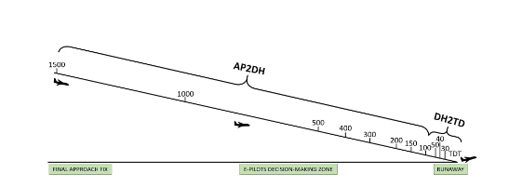
INTRODUCTION
In aviation safety, precise landing prediction is vital.
Integration into cockpit systems offers real-time hard landing prevention, marking a groundbreaking era in aviation safety.
APPROACH PHASE
DECISION HEIGHT
TOUCHDOWN

Slide 7
EXISTING SYSTEM
LSTM models excel but struggle with specific vertical acceleration patterns during Touchdown (TD), limiting real-world cockpit use.

Slide 8
PROPOSED SYSTEM
A novel Hybrid LSTM overcomes this. Tailored LSTM subsets (Pilot, Actuator, Physical) merge for enhanced accuracy, surpassing standalone LSTMs, SVM, and logistic regression.

Slide 9
DISADVANTAGES OF EXISTING SYSTEM
Limited prediction accuracy due to incomplete vertical acceleration foresight.
Lack of real-time alerts hampers timely decision-making.
Compromised passenger safety during landings.
Operational inefficiency and potential disruptions.
Insufficient cockpit integration and communication.
Incomplete feature utilization affects prediction quality.
Absence of hybrid models for optimized accuracy.

Slide 10
ADVANTAGES OF PROPOSED SYSTEM
Enhanced Model Robustness
Effective Utilization of Temporal Dependencies
Optimal Subset Selection
Comprehensive Variable Categorization
Efficient Learning of Complex Relationships

Slide 11
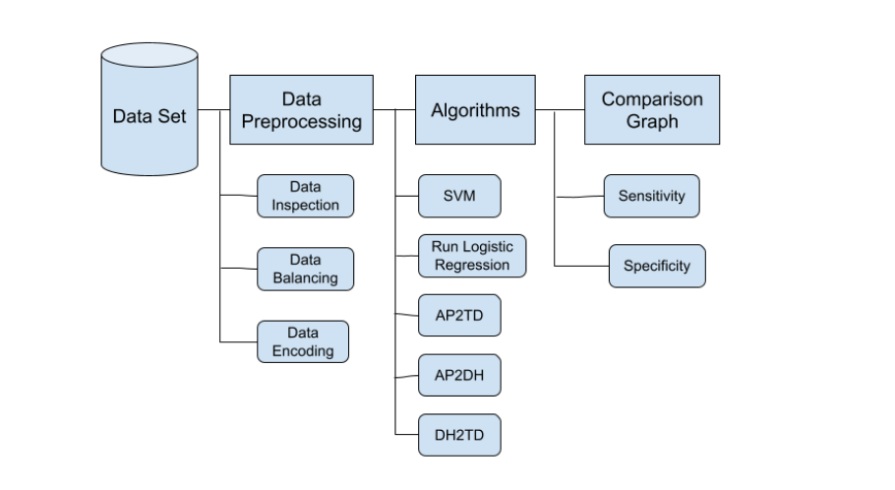
SYSTEM ARCHITECTURE

Slide 12
SOFTWARE REQUIREMENTS
Operating System Coding Language FRONT END
Database
Designing
:
:
:
:
:
Windows 10
Python
HTML, CSS
SQLite
HTML, CSS, Java Script

Slide 13
HARDWARE REQUIREMENTS
System
Hard Disk
Monitor
Mouse
Ram
:
:
:
:
:
Intel i3
1 TB
14’ Colour Monitor
Optical Mouse
4 GB

Slide 14
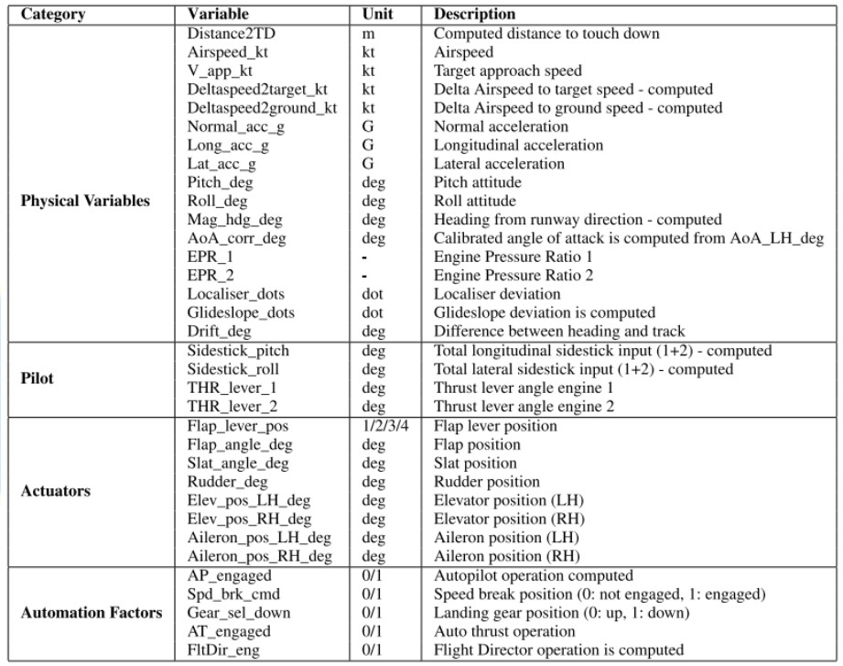
DATA SET

Slide 15
SVM ALGORITHM
The Support Vector Machine (SVM) algorithm is a fundamental tool in binary classification, crucial in predicting hard landings during commercial flight approaches for aviation safety. Our study involved meticulous SVM retraining and fine-tuning, aligning it with specific research variables. Unlike neural networks, SVMs offer simplicity in hyperparameter configuration, but kernel selection requires precision. We conducted extensive grid search optimization to find the best kernel. We rigorously assessed the SVM's performance, emphasizing sensitivity and specificity for hard landing prediction, key to evaluating its role in our system. The SVM serves as a benchmark, comparing this traditional machine learning approach with more complex models like neural networks.

Slide 16
LOGISTIC REGRESSION
Logistic Regression (LR) is another fundamental classification algorithm that plays a crucial role in the prediction of hard landings during the approach phase of commercial flights. Similar to SVM, LR models were retrained from scratch, ensuring that they align with the specified variables and metrics. LR models are relatively straightforward to configure compared to neural networks, as they do not involve complex kernel choices. In this study, LR's role was to provide an essential point of comparison for evaluating the proposed system's performance. The study assessed the LR model's sensitivity and specificity, shedding light on its capability to predict hard landings effectively. While LR may not possess the complexity of neural networks, its simplicity and interpretability are valuable in understanding how traditional machine learning methods stack up against more advanced approaches. Its role in the study contributes to a comprehensive evaluation of the proposed system's predictive power

Slide 17
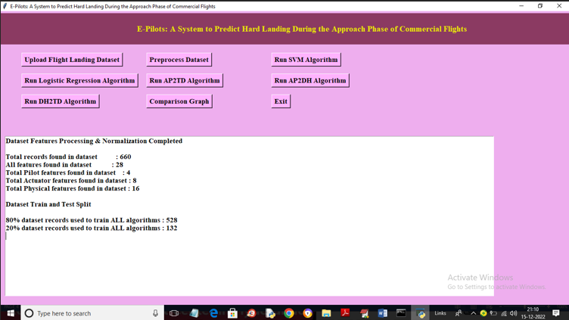
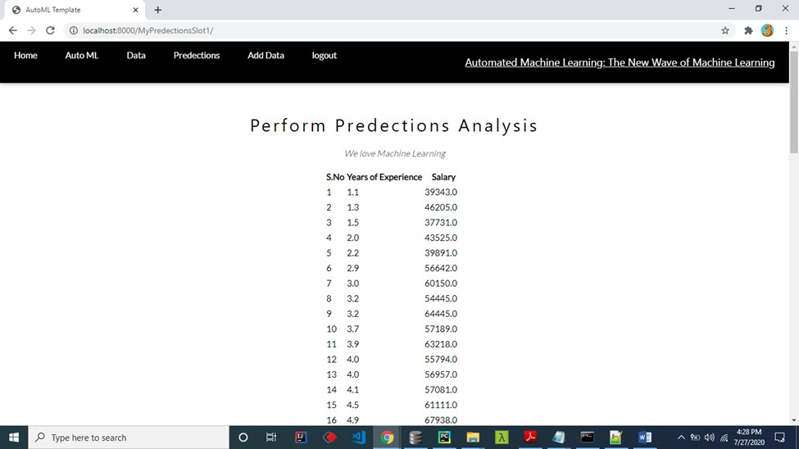

Slide 18
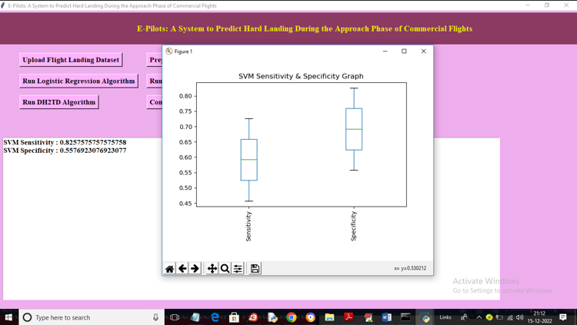


Slide 19
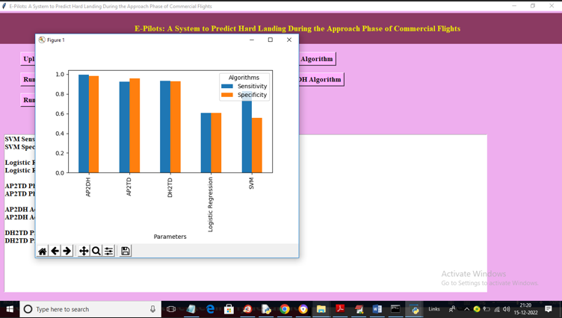
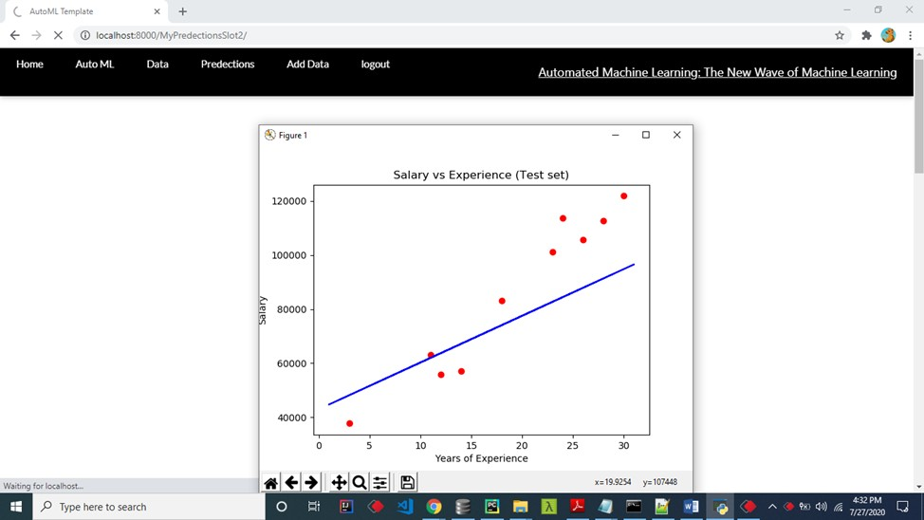

Slide 20
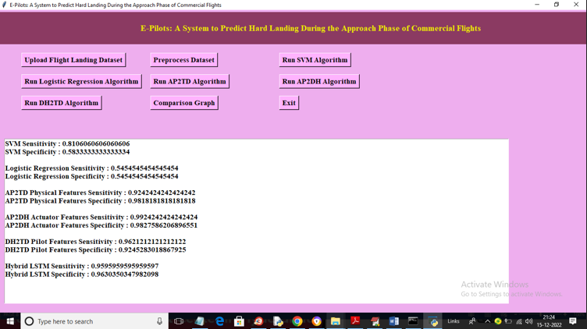

Slide 21
CONCLUSION & FUTURE SCOPE
The analysis reveals that automation factors—autopilot, flight director, auto-thrust—lack influence on Hard Landing (HL) probability, suggesting their omission from models. Optimal architecture minimizes neurons for heightened sensitivity, while models using solely Physical variables achieve 94% recall and 86% specificity, outperforming advanced LSTM methods for early HL prediction within cockpit systems. Classifiers prove superior for early HL prediction compared to regressors, which excel in maxG estimation when considering Touchdown (TD) data. Future exploration could leverage one-dimensional convolutional networks for deep learning features, incorporate aircraft mass and center of gravity, and address robustness under varying conditions, enriching aviation safety protocols.

Slide 22


Shaik Fathima Zahra - 20J41A05B1
Thank You
Mehar Sai Harshitha
- 20J41A0584
Syed Farooq
- 20J41A05B3
Azad Rithvik
- 20J41A0579
GUIDE - DR. P.S.R.C MURTY

